Slide 1
The Battle of Neighborhood- Bangalore restaurant in India

Slide 2
Introduction
Bangalore, formally Bengaluru is the capital of the Indian territory of Karnataka. It has a populace of more than ten million, making it a megacity and the third-most crowded city and fifth-most crowded urban agglomeration in India. It is situated in southern India, on the Deccan Plateau at a rise of more than 900 m (3,000 ft) above ocean level.
Bengaluru is now and then alluded to as the "Silicon Valley of India" (or "IT capital of India") in view of its job as the country's driving data innovation (IT) exporter. Indian technological organisations ISRO, Infosys, Wipro and HAL are headquartered in the city.
This is the Best place for starting the restaurant in India

Slide 3
PROBLEM STATEMENT:
Until now, we can understand that this city is densely populated by migrants as it is “Silicon Valley of India”. Most of the people are from North India and this project is intended to know the best places for north Indian to find best place for their cuisine and to plan the best spot for starting North Indian restaurant in Bangalore, India.

Slide 4
CHALLENGES ADDRESSED IN THIS PROJECT:
In this project the following problems are addressed:
What is best area in Bangalore City for North Indian Cuisine?
Which zones have huge number of North Indian eatery Market?
Which all zones have less number of eatery?
Which is the best spot to start North Indian restaurant?
What spots are have best Indian restaurants in Bangalore?

Slide 5
SOURCE FOR DATA:
Bangalore restaurants information that contains list Locality, Restaurant name, rating alongside their scope and longitude.
The Database for this project is found from the following link
https://www.kaggle.com/shrutimehta/zomato-restaurants-data/tasks
Close by places in every area of Bangalore city:
Information source: Four square API
The data retrieved from Foursquare contained information of venues within a specified distance of the longitude and latitude of the postcodes. The information obtained per venue as follows:
1. Neighbourhood
2. Neighbourhood Latitude
3. Neighbourhood Longitude
4. Venue
5. Name of the venue e.g. the name of a store or restaurant
6. Venue Latitude
7. Venue Longitude
8. Venue Category

Slide 6
PROCEDURE:
Gather the Bangalore city information from Zomato kaggel dataset.
Utilizing Four Square API we will discover all settings for every area.
Channel out all settings that are close by territory.
Utilizing collection rating for every café to locate the best places.
Picture the Ranking of neighborhoods utilizing folium library (python)

Slide 7
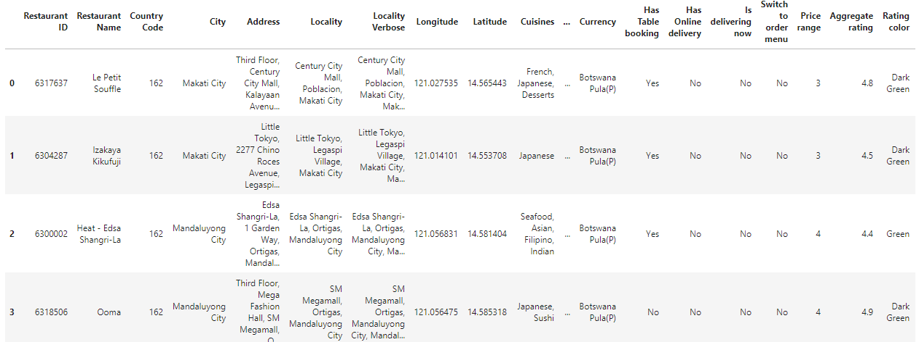
Flow of the project and Results:
1. Read the zomato restaurant data from csv file

Slide 8
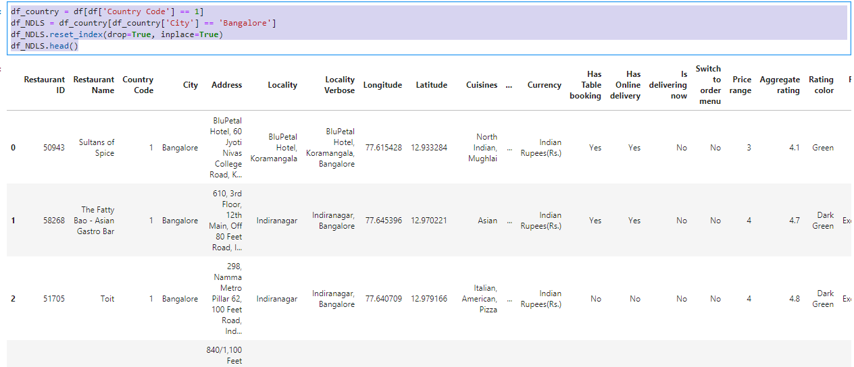
2. Data Cleaning

Slide 9
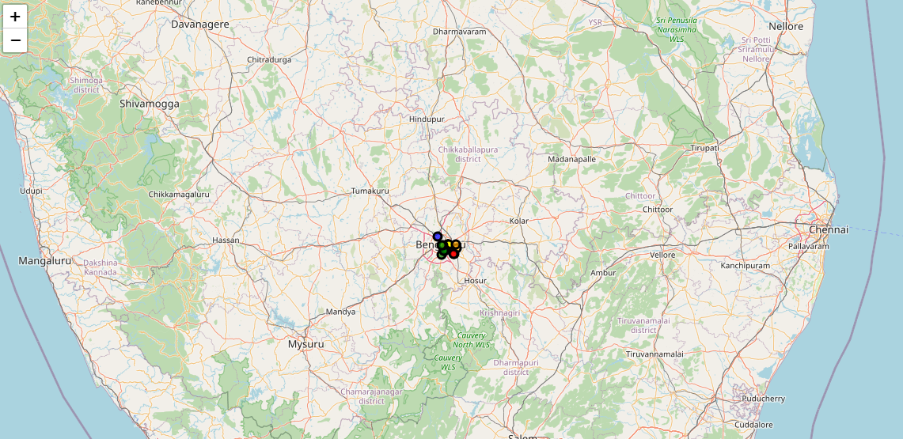
3. Creation of Map to show cluster of restaurants in Bangalore

Slide 10
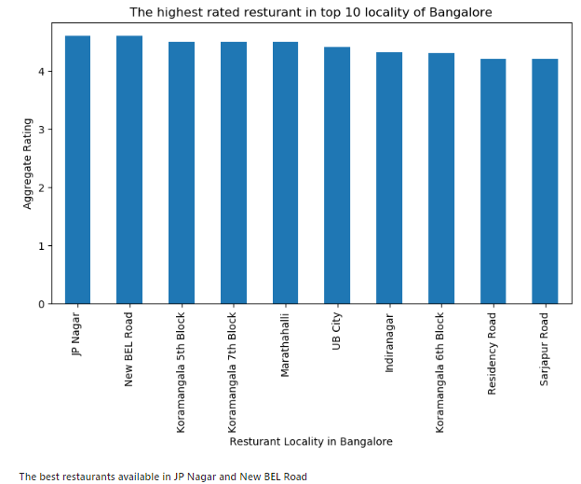
Q1. What is best area in Bangalore City for North Indian Cuisine?

Slide 11
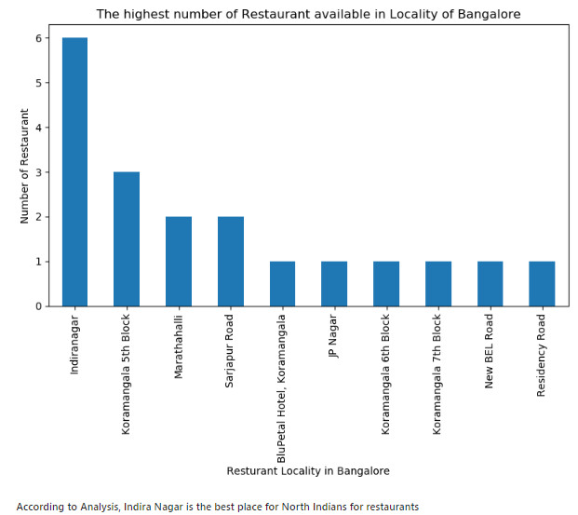
Q 2. Which zones have huge number of North Indian eatery Market?

Slide 12
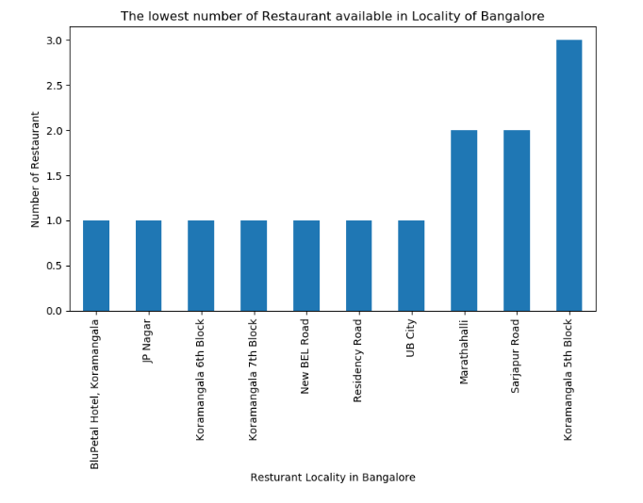
Q 3. Which all zones have less number of restaurants?

Slide 13
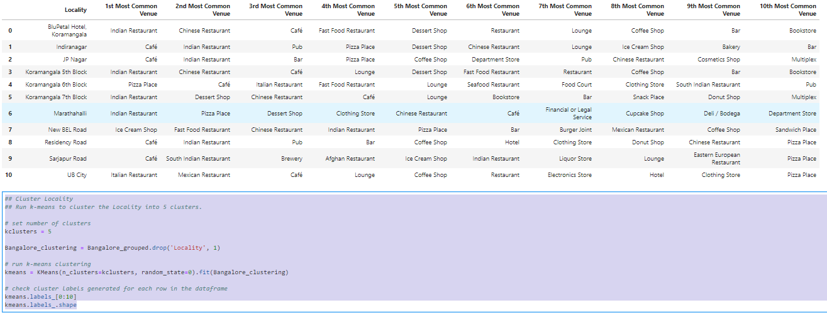
Applying K-means algorithm to cluster the data:

Slide 14
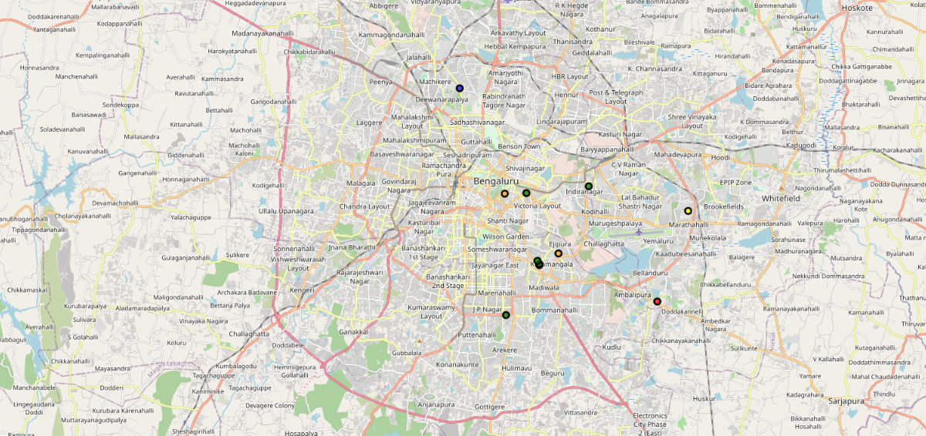
creating final map:

Slide 15
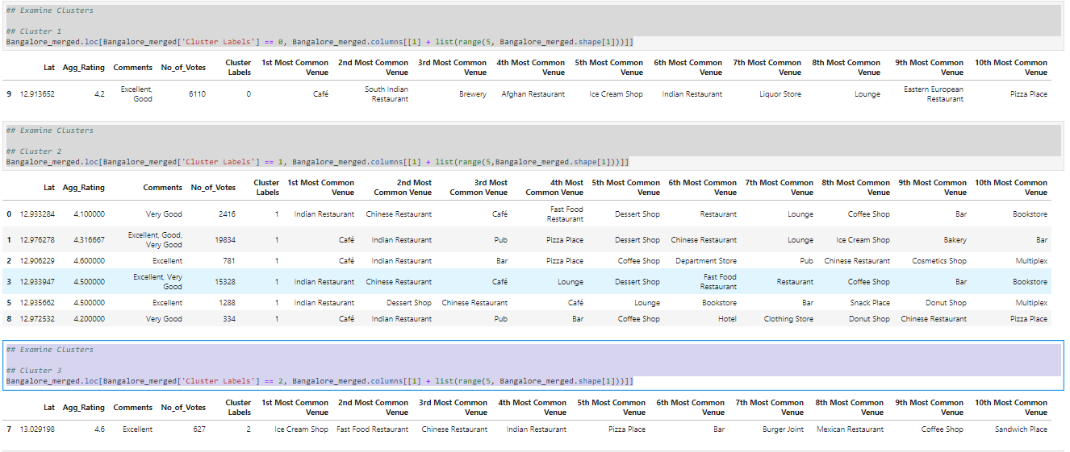
Cluster 1 to 5:

Slide 16
Conclusion:
Koramanagala 5th & 6th Block are have best neighborhood of North Indian Restaurants
Koramanagala 6th block has best restaurant as per the ratings.
Indira Nagar is best place for Opening a New Restaurant.
JP nagar, New BEL road, Koramangalam Marthali have best restaurants in Bangalore.
Cluster 1: This zone is recommended for Cafes.
Cluster 2: This zone is recommended for Indian Restaurants.
Cluster 3: This zone is recommended for Ice Cream shops and Fast food Restaurants.
Cluster 4: This zone is recommended for Pubs and Night clubs.
Cluster 5: This zone is recommended for Italian and Mexican Restaurants.

